Slide 1
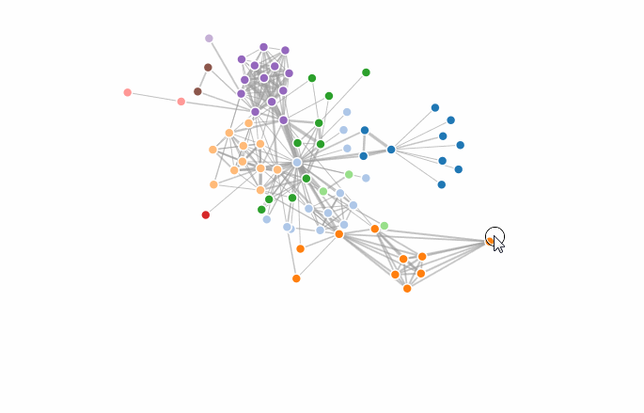
Cluster Data with D3
Team Visualantes
- Tejas Karangale
- Scarlett Dias
- Vaisakhi Mishra

Slide 2
Motivation

Slide 3
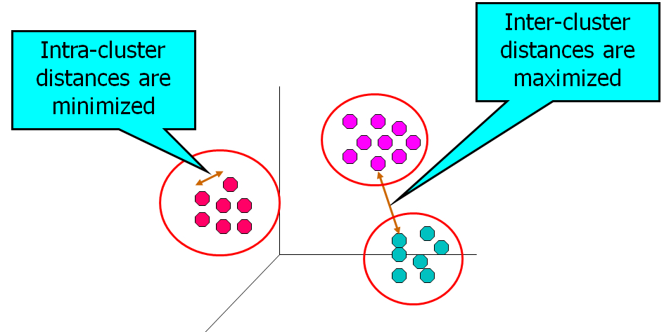
Clustering: An Overview
Unsupervised machine leaning algorithm
Divides the data points into logical groups such that data points in the same group are similar to each other than the points in other groups

Slide 4
What is K-means Clustering?

Slide 5
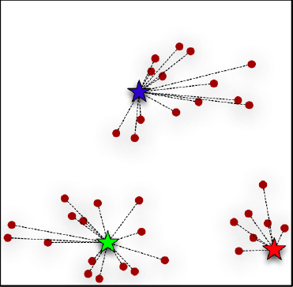
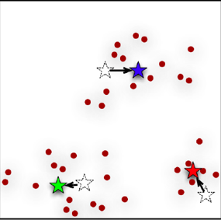
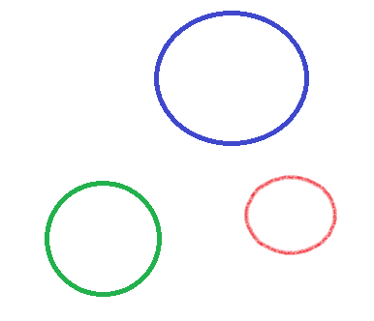
Algorithm
Main Goal: Divide the data points into no. of clusters specified by the variable K
Specify the number of clusters (K) to be created
Select k objects from the dataset as centroids
1. Assign each data point to its closest centroid based on the Euclidean distance or Manhattan distance between the centroid and the point
2. Update the cluster centroid to the mean of all the points currently present in the cluster.
Repeat 1 and 2 till local optimum is reached.

Slide 6
Related Work

Slide 7
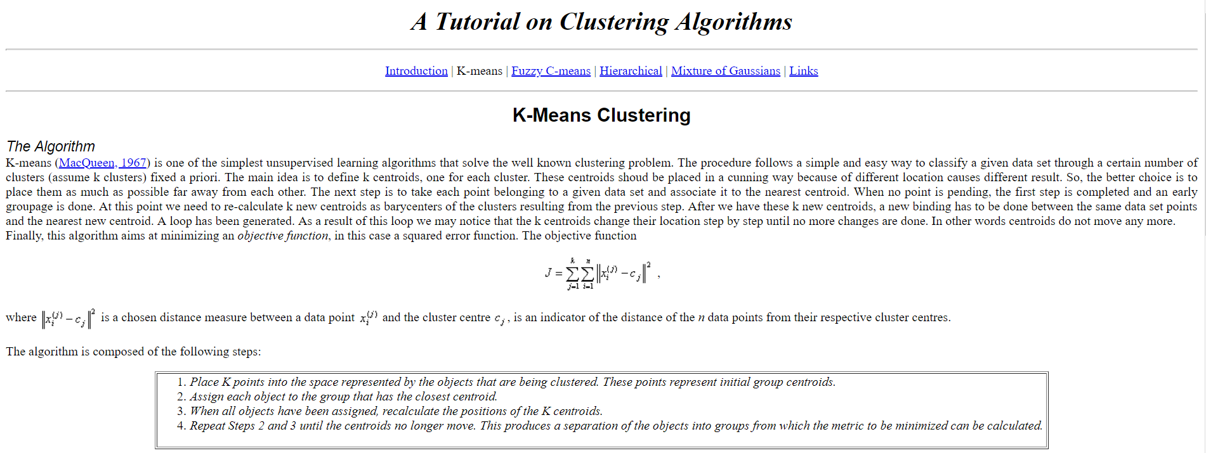
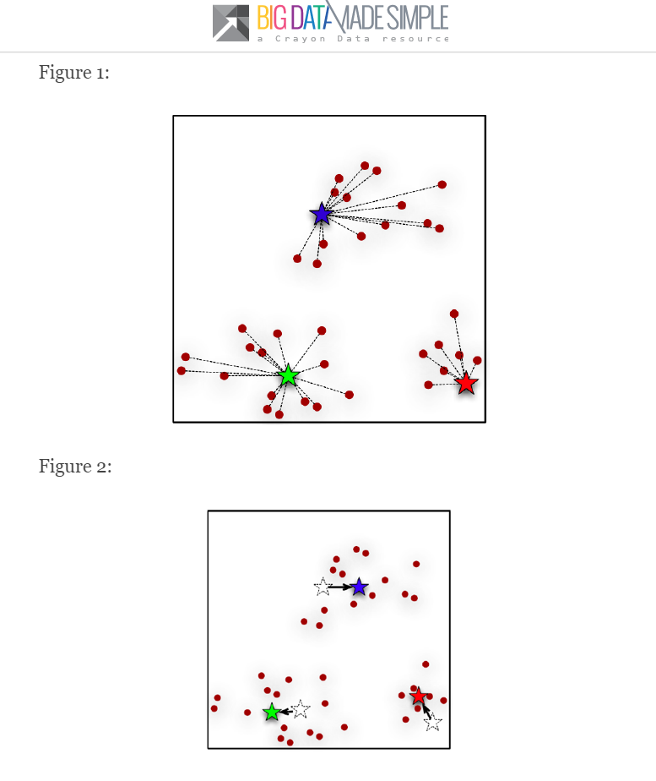
Related Work
Static Explanations
(https://minerva.leeds.ac.uk/bbcswebdav/orgs/SCH_Computing/FYProj/reports/0708/Goffin.pdf)
(http://bigdata-madesimple.com/possibly-the-simplest-way-to-explain-k-means-algorithm/)

Slide 8
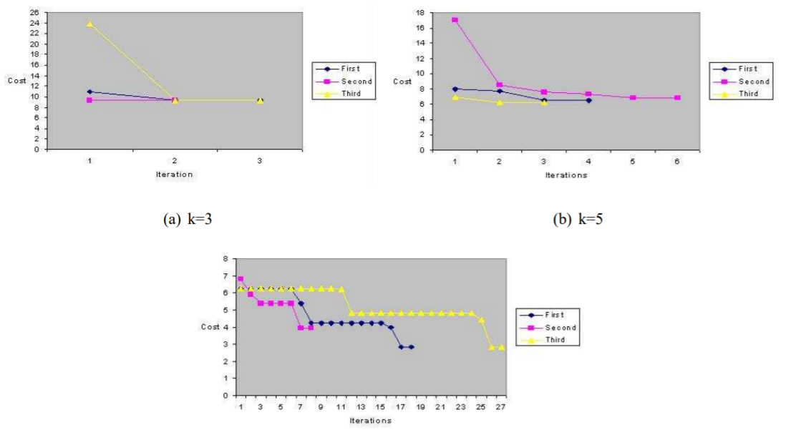
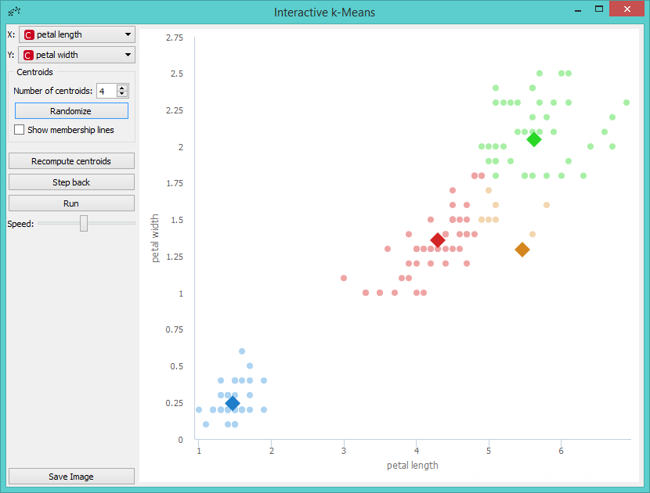
Related Work
Very Few Interactive Explanations
Java/Flash based applications
Inadequate information about working of K-Means.
Goffin, P. (2008). Interactive Tutorial for Understanding of the K-Means Algorithm. Leeds. (https://minerva.leeds.ac.uk/bbcswebdav/orgs/SCH_Computing/FYProj/reports/0708/Goffin.pdf)
(https://orange3-educational.readthedocs.io/en/latest/widgets/kmeans.html)

Slide 9
Our Idea, Our Storyboard

Slide 10
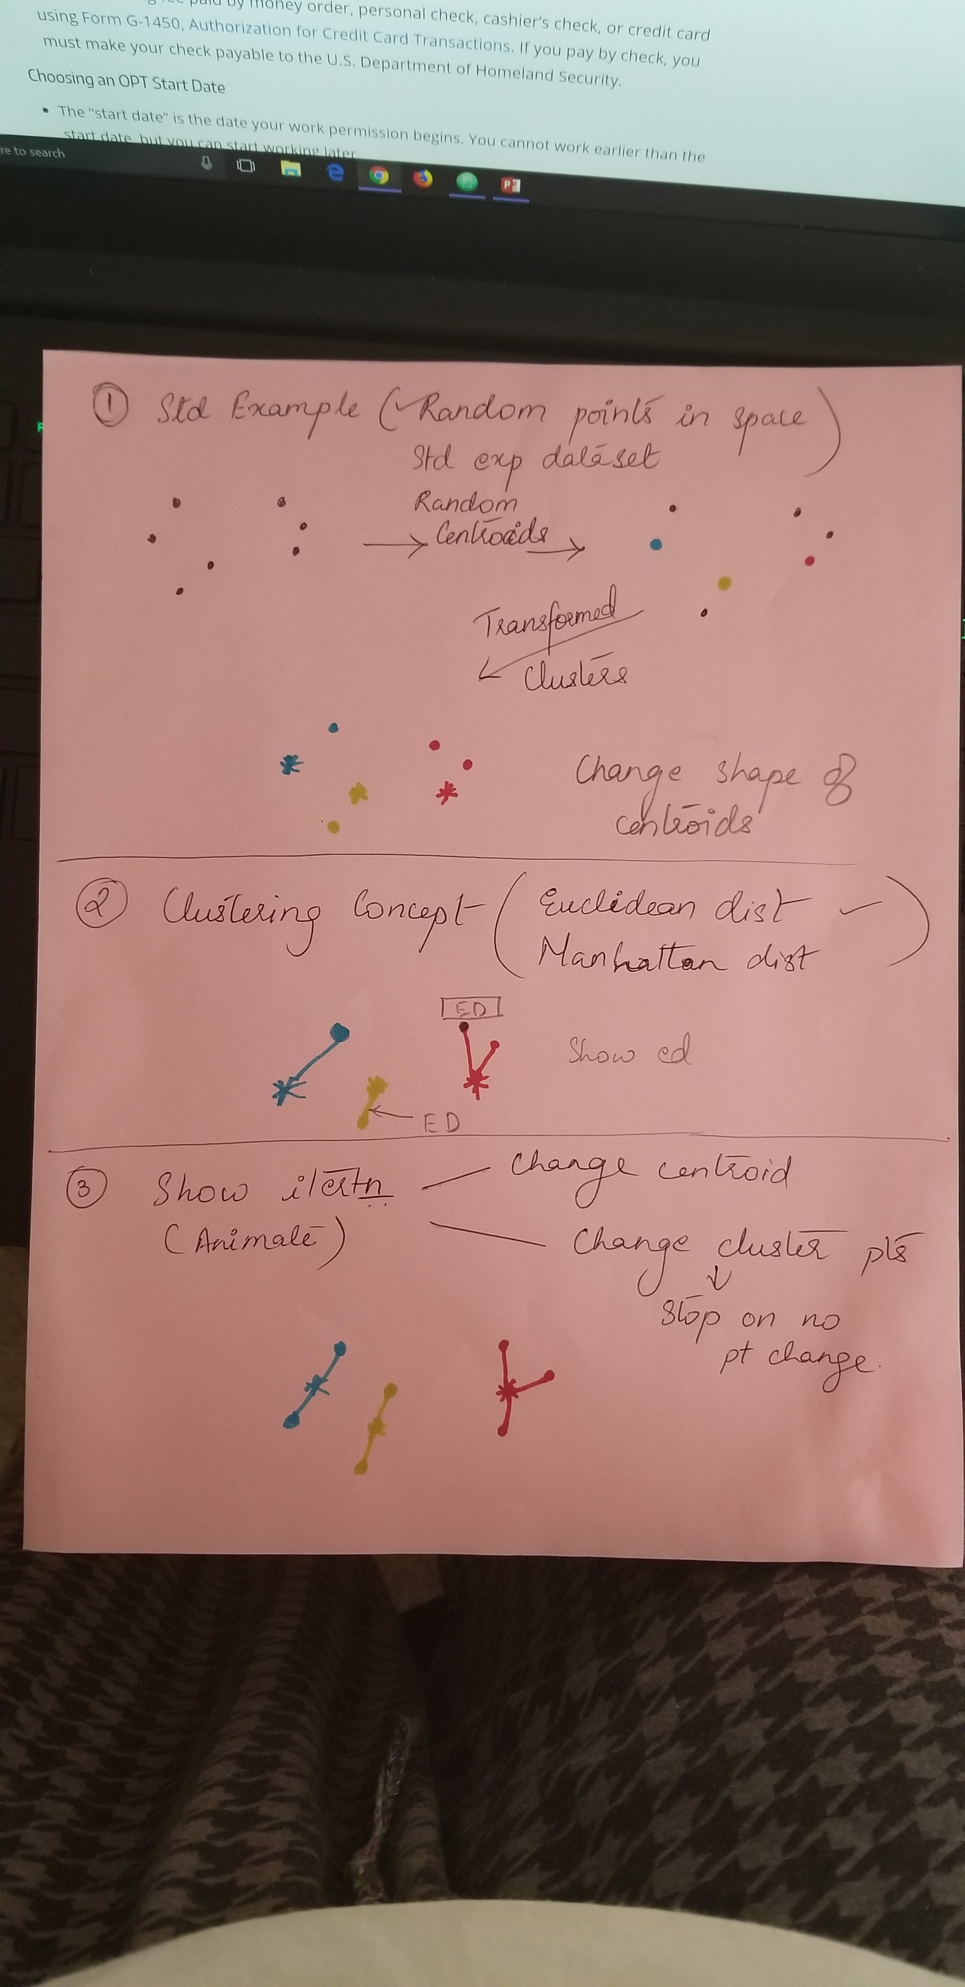
StoryBoard
Initial Scatterplot graph
Create Clusters
Animate till Optimum

Slide 11
Tutorial’s Structure

Slide 12
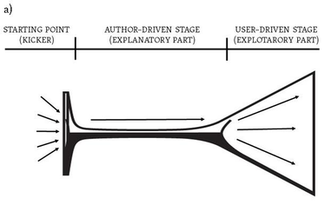
Structure
Martini Glass Structure

Slide 13
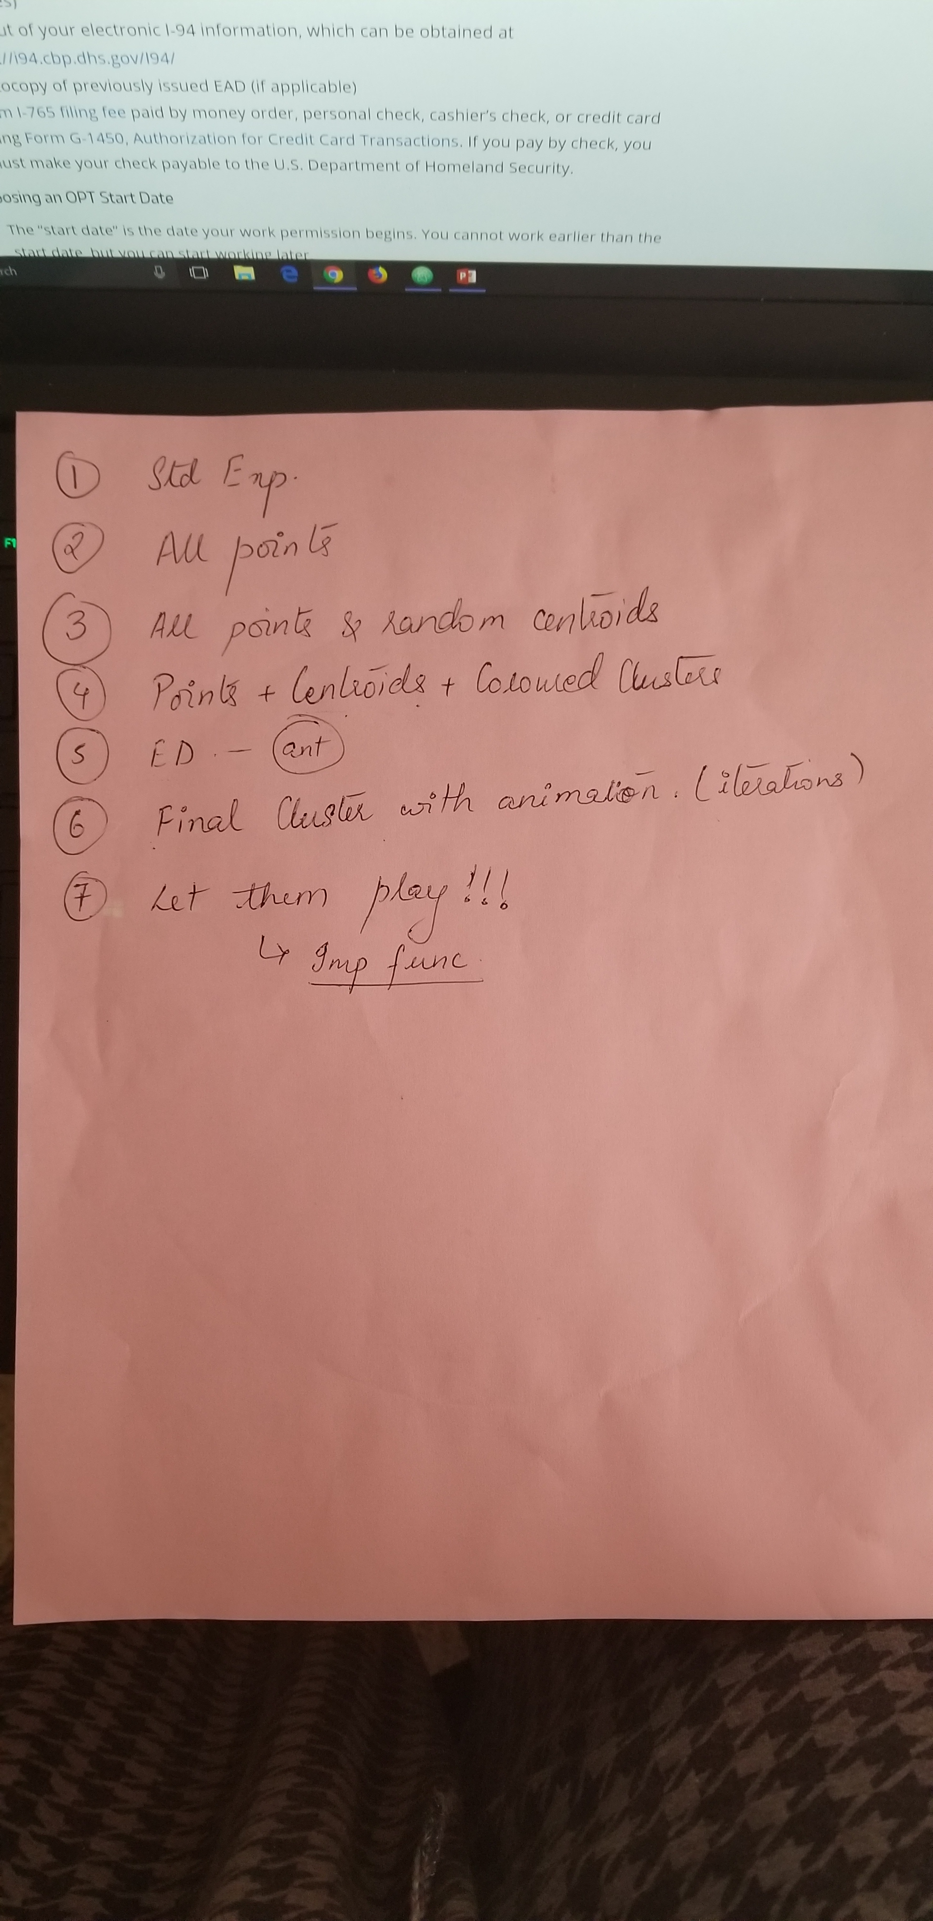
Content
Website Structure
Starting Point
Explanatory Part
Exploratory Part

Slide 14
What we did
The Demo

Slide 15
Who did what?
Storyboarding (Team)
Tutorial Text (Tejas)
K-Means Algorithm implementation in JS (Vaisakhi)
Animated Viz to show step through for K-Means cluster changes (Tejas)
Interactive Viz (Vaisakhi)
Scrolling (Scarlett)
Collation of code and finalizing viz (Scarlett)
Report (Team)

Slide 16
Thanks!
Q & A

